Slide 1
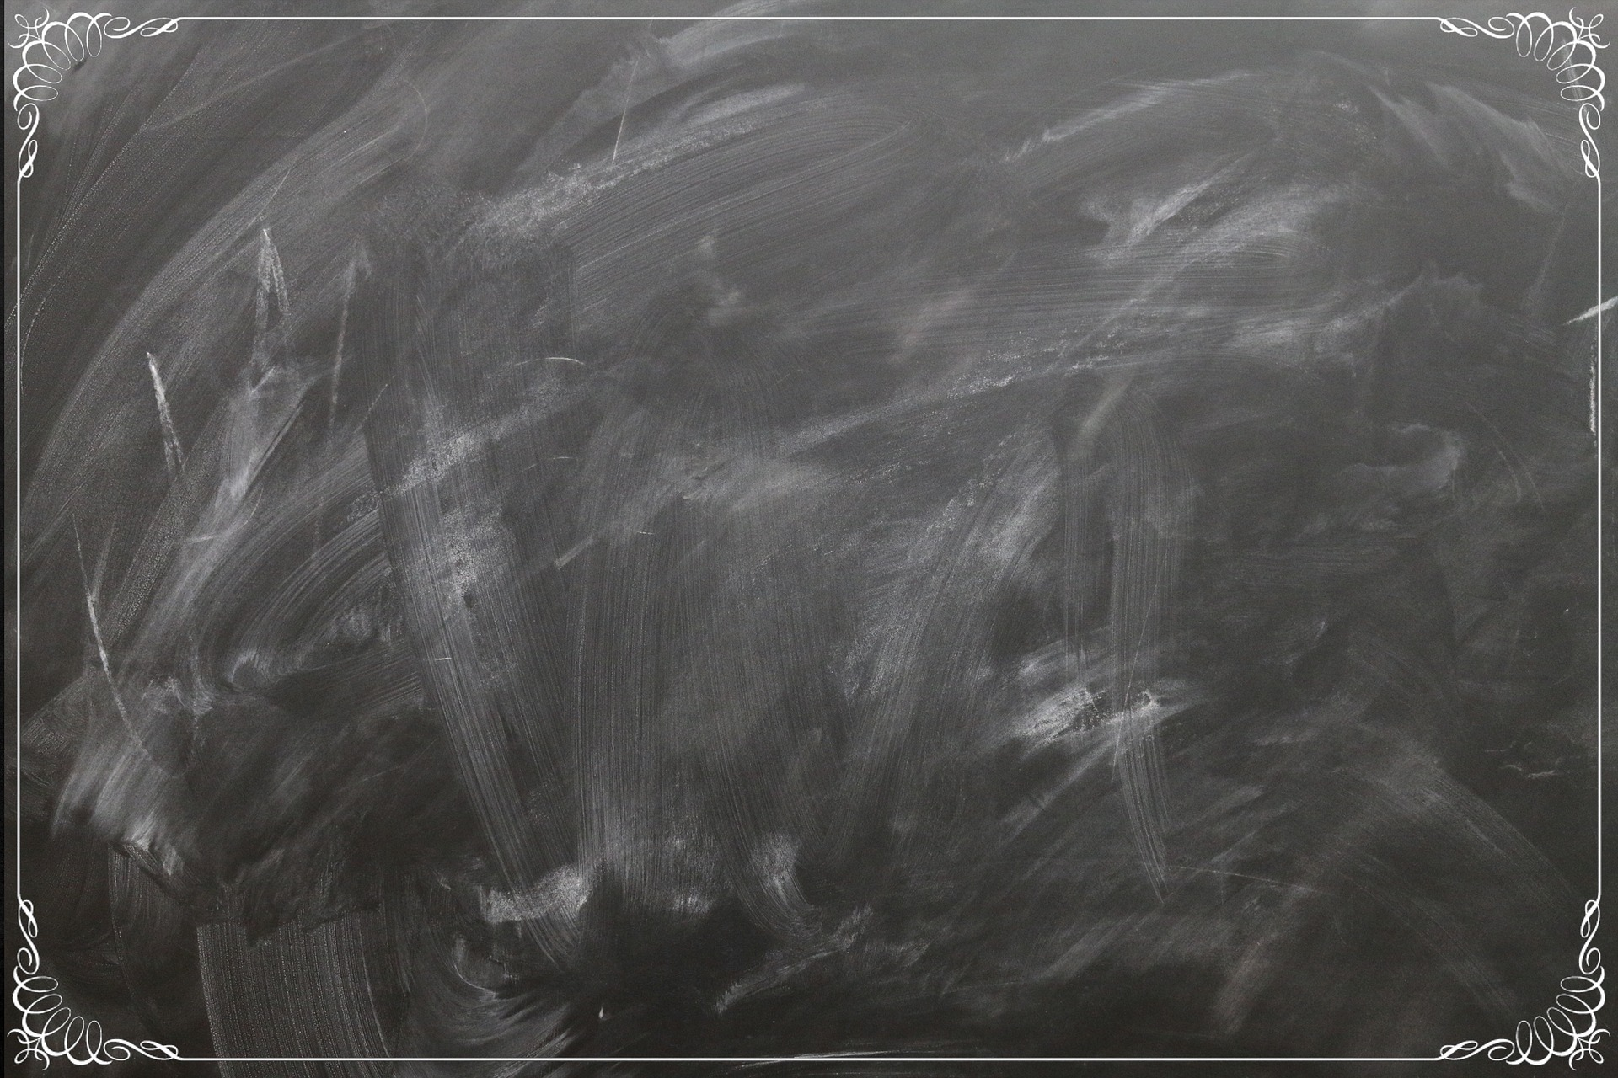
Stories
Stella the Storks Sprecial Delivery
The Gingerbread Man
The Queen From the Land of Snow
Doris the Dredger and the Big Storm
The Little Big Clockmaker
Hodgepodge
Peter Rabbit
The Why Word
An Imp Called Boo
April Fool

